Slide 1
Welcome Husnain
With MuHammad Hammad

Slide 2
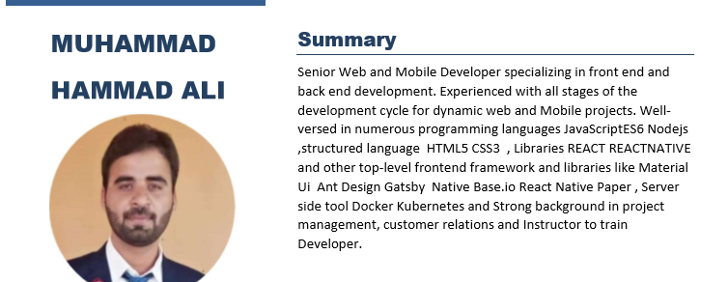

Slide 3
Lern,INTERN,eARN
Muhammad HAMad

Slide 4

Tool
Vs code

